Slide 1
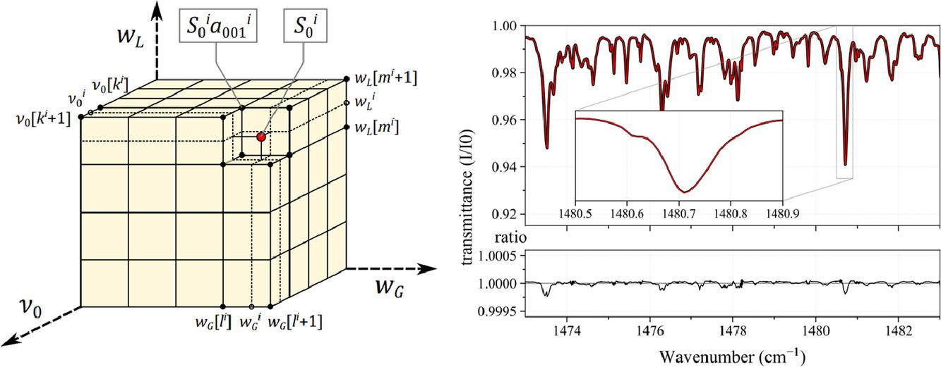
P5367: Improving Spectral Synthesis Performance by up to 5 orders of magnitude with the Discrete Integral Transform Approach
Dirk van den Bekerom^{1,2}, Pankaj Mishra³, Erwan Pannier⁴
1. Combustion Research Facility, Sandia National Laboratories, Livermore, CA, USA
2. Department of Mechanical and Aerospace Engineering, The Ohio State University, Columbus, OH, USA
3. Electronics and Electrical Communication Engineering, Indian Institute of Technology, Kharagpur, India
4. Laboratoire EM2C, CNRS UPR288, CentraleSupelec, Universite Paris Saclay, Gif sur Yvette, France
1

Slide 2
Outline
Introduction
Conventional method
New method
Benchmarks
GPU implementation
Concluding remarks
2
Notes:
Here’s the outline for today’s talk.
After a general introduction I will quickly review the conventional synthesis method that is mostly used today.
Then I will go into the details of our new method, and present benchmarks comparing the new method with the old one, where we find the new method shows a 2-3 order of magnitude improvement.
After that I will very briefly talk about an experimental GPU implementation with which we were able to achieve an additional 2 orders of magnitude improvement.
And finally I will finish off with some concluding remarks.

Slide 3
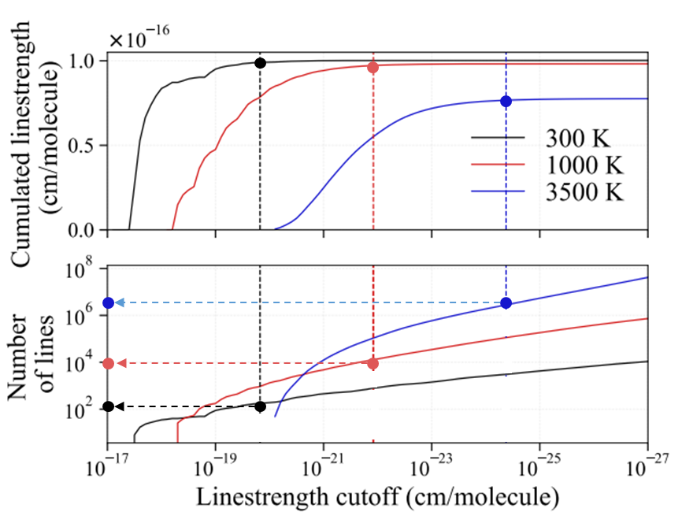
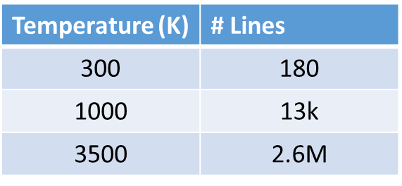
Introduction
Lines needed for 99% accumulated linestrength:
Line-by-line models are used to:
Tabulate cross-sections / opacities / extinction coefficients
Derive approximate models (e.g : SNB / C-K band models)
Direct comparison with experimental data (ex : fitting laboratory Plasma)
High accuracy spectra are required for
More accurate radiative transfer modeling (combustion, heat-transfer)
Prepare for new high-resolution instruments (ex: JWST for exoplanet detection)
Problem: higher accuracy = more lines !
3
Notes:
My talk today is about the synthesis of spectra from large line-by-line databases.
Line-by-line databses are used in a number of applications such as tabulating cross-sections, opacities, and extinction coefficients
They are used for deriving approximate models such as SNB and C-K band models
And they can be used in direct comparison with experimental data, such as in fitting spectra of high-temperature combustion or plasmas.

Slide 4
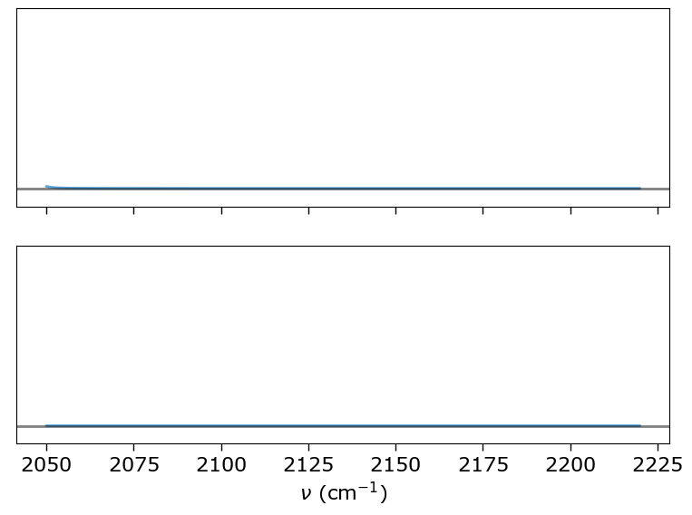
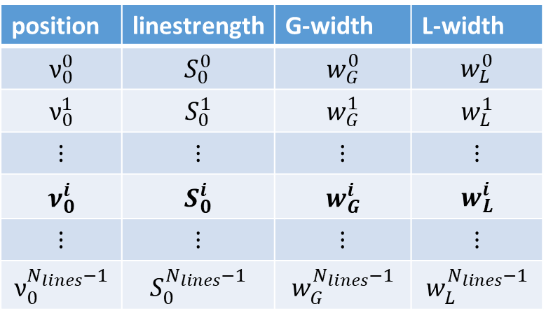
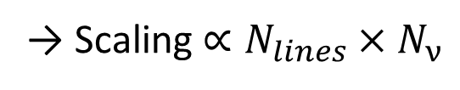
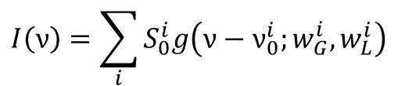
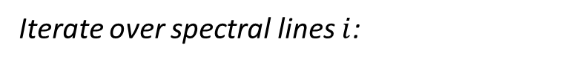
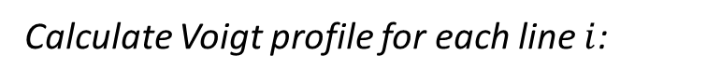
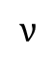
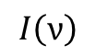
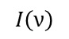
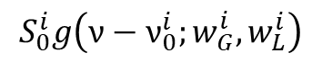
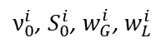
Conventional method
Calulate linstengths & widths
Apply broadening
T, p, x, …
$ν_{0}^{i}$, $S_{0}^{i}$, $w_{G}^{i}$, $w_{L}^{i}$
$$I\left(ν\right)$$
LBL-database
$$ν$$
Calculate Voigt profile for each line $i$:
Iterate over spectral lines $i$:
$$S_{0}^{i}g\left(ν−ν_{0}^{i};w_{G}^{i},w_{L}^{i}\right)$$
$$I\left(ν\right)$$
Problem: more lines = slower synthesis!
$$I\left(ν\right)=\sum_{i}{S_{0}^{i}g\left(ν−ν_{0}^{i};w_{G}^{i},w_{L}^{i}\right)}$$
→ Scaling $∝N_{lines}×N_{ν}$
Truncation: tradeoff between performance and accuracy
4
Notes:
A spectrum is usually synthesized by taking input parameters such as temperature, pressure, and molefractions, to process a Line-by-Line database that outputs the line position, line strength, Gaussian width and Lorentzian width for each line.
These four parameters per line are then used to produce a broadened output spectrum. This second broadening step is almost always the bottleneck, and this is where our approach focuses on.
In the conventional method the output spectrum is generated by iterating over the spectral lines in the line list and calculating a Voigt profile for each line.
All these profiles are then added together to get the output spectrum
Because in this method we produce a lineprofile for every line, the computation time scales with the number of spectral lines times the number of spectral points.
This is a problem for large databases, as the computation time will increase and increase as we include more lines.
Line profiles are often truncated to improve performance, but this is at the cost of the accuracy of the output spectrum.
A more substantial improvement could be obtained when the line profile is constant, as the broadening would only have to be applied once.

Slide 5
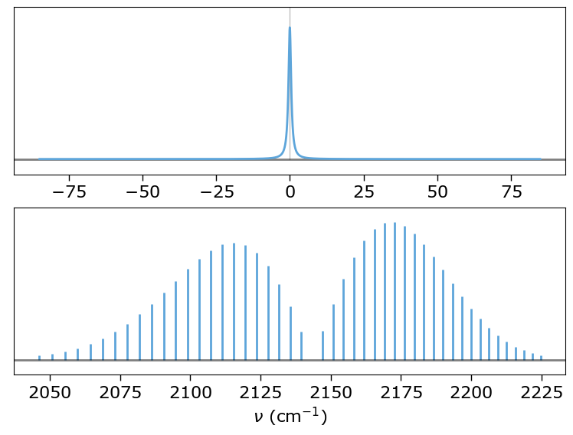
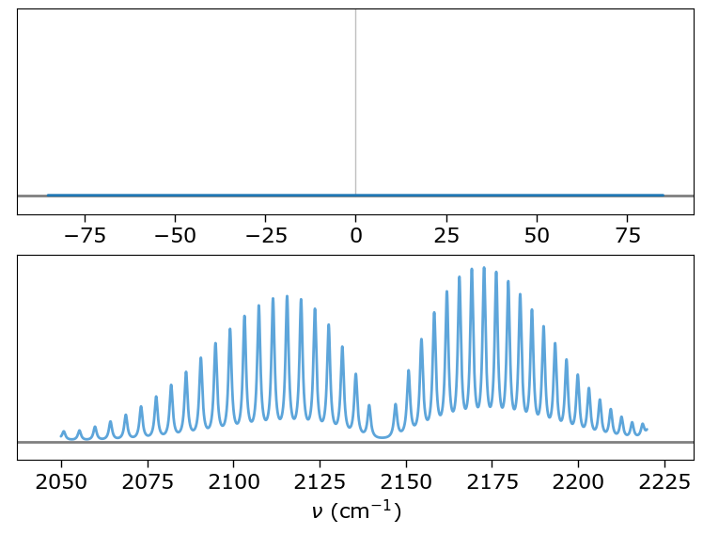
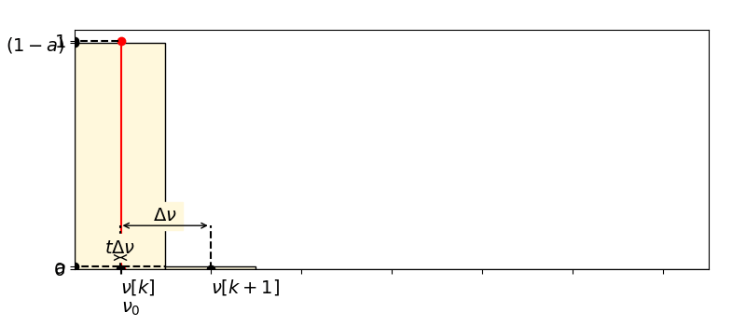
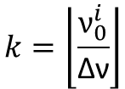
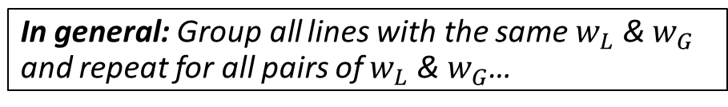
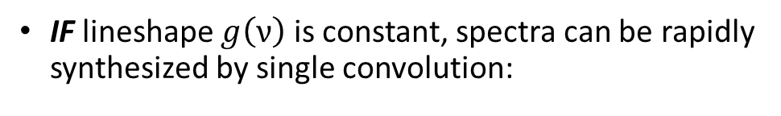
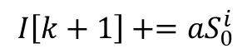
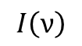
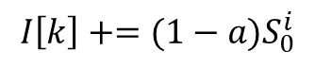
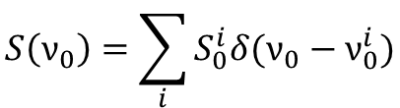
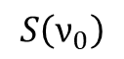
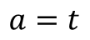
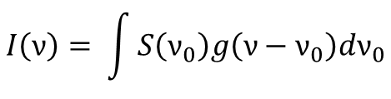
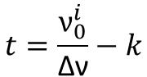
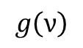
Inspiration for new method
$$g\left(ν\right)$$
IF lineshape $g\left(ν\right)$ is constant, spectra can be rapidly synthesized by single convolution:
“Stick spectrum”:
$$S\left(ν_{0}\right)=\sum_{i}{S_{0}^{i}δ(ν_{0}−ν_{0}^{i})}$$
$$S\left(ν_{0}\right)$$
Convolve with lineshape:
$$I\left(ν\right)= \int{S\left(ν_{0}\right)g\left(ν−ν_{0}\right)dν_{0}}$$
$$I\left(ν\right)$$
→ In reality, stick spectrum is discrete…
For each line, distribute intensity over two neighboring grid points:
$$I\left[k\right]+=(1−a)S_{0}^{i}$$
$$I\left[k+1\right]+=aS_{0}^{i}$$
Grid index:
Grid alignment:
Weight:
$$k=\left\lfloor \frac{ν_{0}^{i}}{\text{∆}\text{ν}}\right\rfloor$$
$$t=\frac{ν_{0}^{i}}{\text{∆}\text{ν}}−k$$
$$a=t$$
In general: Group all lines with the same $w_{L}$ & $w_{G}$ and repeat for all pairs of $w_{L}$ & $w_{G}$…
5
Notes:
If, hypothetically, the lineshape was constant for all lines in the line list, we could efficiently calculate the output spectrum as the convolution of the line profile with a stick spectrum, which is defined as the sum of delta peaks at the position of the spectral line multiplied by the line’s linestrength.
To store the stick spectrum on the computer however, it must first be discretized in some way.

Slide 6
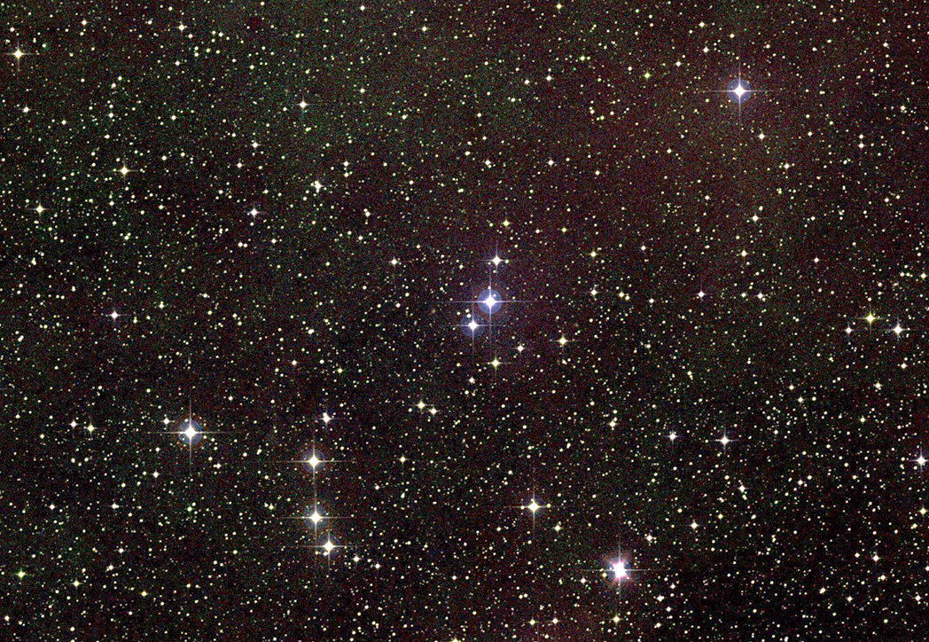
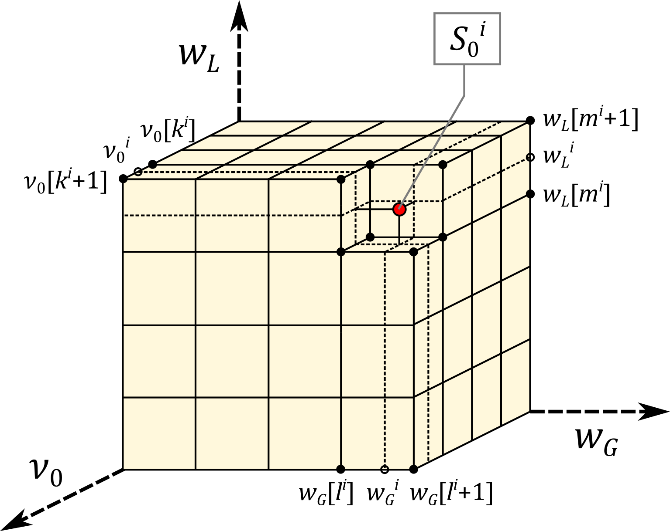
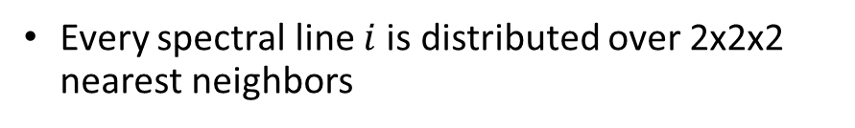
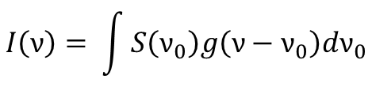
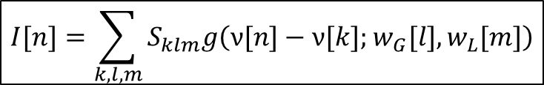
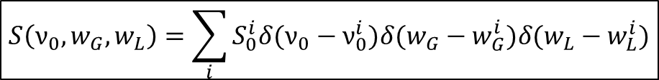
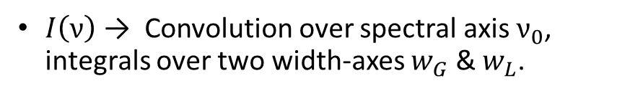
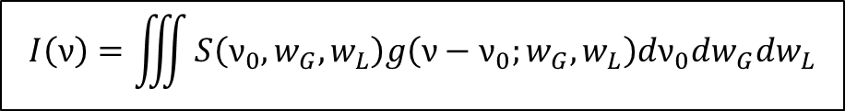
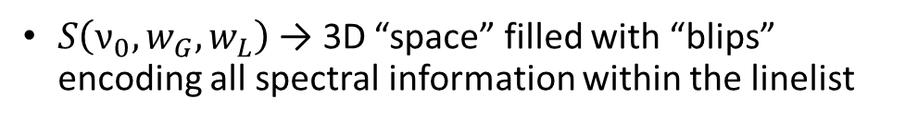
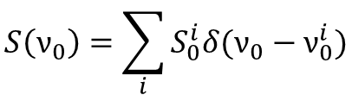

New method – Integral transform
“Lineshape distribution function”
Generalize convolution method:
$$S\left(ν_{0}\right)=\sum_{i}{S_{0}^{i}δ(ν_{0}−ν_{0}^{i})}$$
$$S\left(ν_{0},w_{G},w_{L}\right)=\sum_{i}{S_{0}^{i}δ(ν_{0}−ν_{0}^{i})δ(w_{G}−w_{G}^{i})δ(w_{L}−w_{L}^{i})}$$
“Stick spectrum”:
Convolve with lineshape:
$$I\left(ν\right)= \int{S\left(ν_{0}\right)g\left(ν−ν_{0}\right)dν_{0}}$$
$$I\left(ν\right)=\iiint{S\left(ν_{0},w_{G},w_{L}\right)g\left(ν−ν_{0};w_{G},w_{L}\right)dν_{0}dw_{G}dw_{L}}$$
$S\left(ν_{0},w_{G},w_{L}\right)$ → 3D “space” filled with “blips” encoding all spectral information within the linelist
$I\left(ν\right)$ → Convolution over spectral axis $ν_{0}$, integrals over two width-axes $w_{G}$ & $w_{L}$.
Discrete version:
$$I[n]=\sum_{k,l,m}{S_{klm}g\left(ν[n]−ν[k];w_{G}[l],w_{L}[m]\right)}$$
Every spectral line $i$is distributed over 2x2x2 nearest neighbors
**NOTE: $S\left(ν_{0},w_{G},w_{L},…\right)$ could be higher dimensional to accommodate additional lineshape parameters!
6
Notes:
Instead it’s more helpful to have another look at the equations and extend them to allow for varying line profiles.
For the constant lineshape we had to generate a stick spectrum and convolve it with the lineshape. This can be generalized by multiplying the stick spectrum with dirac delta’s for the Gaussian and Lorentzian width.
We call the resulting function the “lineshape distribution function” which is now a function of the Gaussian and lorentzian width-axes, in addition to the spectral axis.
The lineshape distribution function can be thought of as a 3D space that is only non-zero at those coordinates where there is a spectral line with those exact line position and linewidths. I find it useful to compare this with stars in the universe, which can be considered as points in a 3D-space, each with their own an intensity.
To obtain the output spectrum, the lineshape distribution function must be convolved with the lineshape, and integrated over the two width-axes.
Like before, we need a discrete version to use it in a program. The integrals can be replaced by sums, but like before, we must now account for the dirac delta’s in 3D space.
Instead of having 2 nearest neigbors, in 3D space each spectral line has now 2x2x2=8 nearest neighbors, over which the linstrength should be distributed.
Finally before we move on, so far I have talked about 3D space because the Voigt profile takes 3 input parameters. In principle this approach can be used for advanced profiles with more than 3 parameters as well, in which case the lineshape distribution function will be higher dimensional.

Slide 7
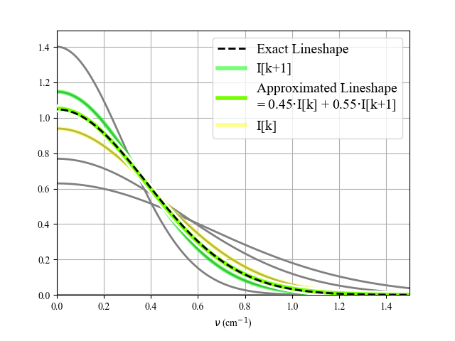
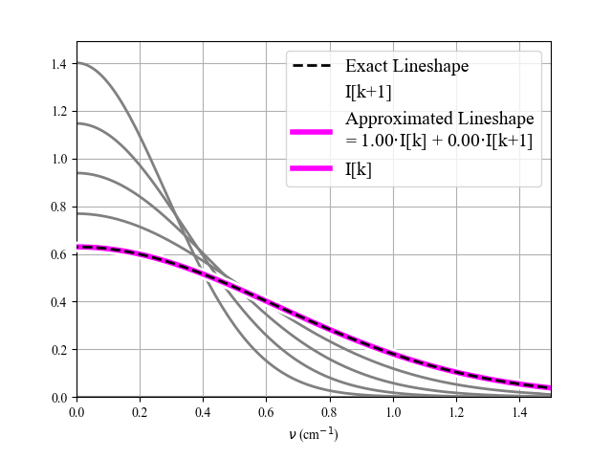
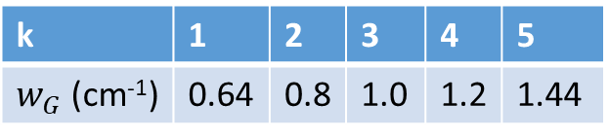
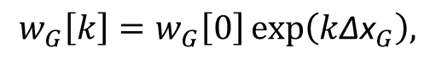
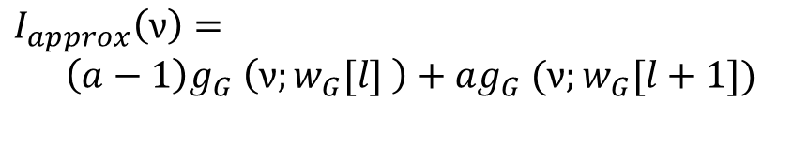
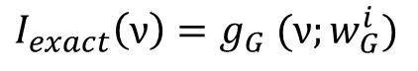
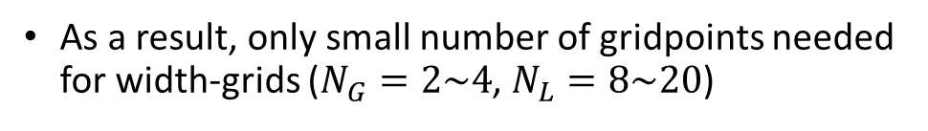
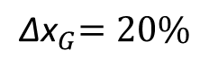
New method – Discretizing widths
New method only fast if $N_{G}$ and $N_{L}$ are small
Can a lineshape of arbitrary width be expressed as weighted sum of lineshapes with discrete widths?
Exact lineshape:
$$I_{exact}\left(ν\right)=g_{G} (ν;w_{G}^{i})$$
Exponential width grid:
$$w_{G}\left[k\right]=w_{G}\left[0\right]\exp\left(k{\text{∆}\text{x}}_{G}\right),$$
$${\text{∆}\text{x}}_{G}=20\%$$
Approximated lineshape very close to exact, even at 20% width-grid spacing!
Approximated lineshape:
$$I_{approx}\left(ν\right)=$$
$$\left(a−1\right)g_{G} \left(ν;w_{G}[l] \right)+ag_{G} (ν;w_{G}[l+1])$$
As a result, only small number of gridpoints needed for width-grids ($N_{G}=2\sim 4$, $N_{L}=8\sim 20$)
7
Notes:
Since the new method requires to take the sum over three distinct axes, it can only be efficient if the grid size of the two width-grids remains small.
In other words, we need to find out how well a lineshape of arbitrary with can be approximated by the weighted sum of two lineshapes with discrete widths.
To this, we plot an exact Gaussina lineshape in the plot on the right depicted by the dashed black curve.
Then we plot 5 lineshapes with a discrete width in gray, each having a width that differs by 20%
The approximated lineshape is the colored solid line, which is a weighted sum of the two nearest neighbor lineshapes, also shown colored.
As we vary the width of the exact lineshape, we see that the approximated lineshape very closely matches the exact linshape regardless of its width.
Because the grid spacing of 20% is relatively coarse, this means that the number of gridpoints in the Gaussian width-axis can be very small. For a Lorentzian lineshape we find a similar result.

Slide 8
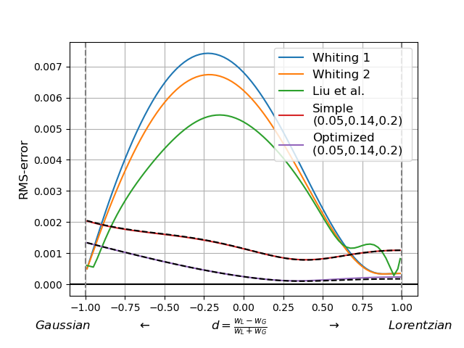
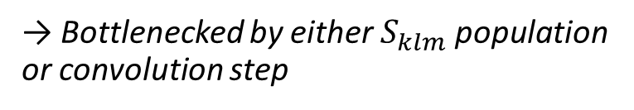
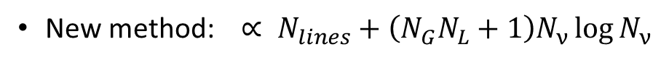






New method - Voigt profiles with arbitrary accuracy
Calculate convolution in Fourier space:
$$I[n]=\sum_{k,l,m}{S_{klm}g\left(ν[n]−ν[k];w_{G}[l],w_{L}[m]\right)}$$
$$=𝔉^{−1}\left\{\sum_{l,m}{𝔉\left[S_{klm}\right]\hat{g}\left(\hat{ν}[k];w_{G}[l],w_{L}[m]\right)}\right\}$$
→ $\left(N_{G}N_{L}+1\right)$ FT’s needed
$$\hat{g}\left(\hat{ν};w_{G},w_{L}\right)=\frac{1}{∆ν}\exp\left\{−\left[\frac{{\left(π\hat{ν}w_{G}\right)}^{2}}{4\ln{2}}+π\left|\hat{ν}\right|w_{G}\right]\right\}$$
= Exact FT of the Voigt profile (no approximation needed)!!
Performance:
Whiting
Conventional method: $∝N_{lines}×N_{ν}$
New method: $∝ N_{lines}+\left(N_{G}N_{L}+1\right)N_{ν}\log{N_{ν}}$
→ Bottlenecked by either $S_{klm}$ population or convolution step
$${\text{∆}\text{x}}_{G}=14\%$$
New method
$${\text{∆}\text{x}}_{L}=20\%$$
Accuracy:
Voigt profile is approximated by weighted sum of exact Voigts → Arbitrary accuracy!
8
Notes:
As many of you will know, convolutions can be calculated efficiently as a product in Fourier space.
Typically, this means we need to perform two forward FT’s and one reverse for each convolution.
In this case, we can first apply the summations over the two with-axis, and only apply the reverse transform once.
Moreover, since the FT of the lineshape is known exactly, we can use the algebraic form and don’t need to do a numeric transform.
This means that the total number of transformations is the Gaussian grid-size, times the lorentzian grid-size, plus one.
One major benefit of defining the Voigt function in Fourier space is that we can use an exact function, and thus don’t have to rely on an approximation to the Voigt profile.
The application of the fourier transform in this way has implications for both performance and accuracy.
Recall that the computation time of the conventional method scales with the number of lines times the number of spectral points.
The new method scales with the number of lines, plus NgNL+1 times NlogN
This means that the new method can be bottle-necked by either the population of the lineshape distribution function, or by the convolution step. When it is bottlenecked by the convolution step, the number of lines in the spectrum can be increased without noticeably increasing the computation time.
In terms of accuracy, our line profile is not quite an exact Voigt profile, but it is a Voigt profile approximated by the weighted sum of 8 exact voigt profiles. This does mean that by decreasing the stepsize of the width grids, the exact Voigt profile can be approximated with arbitrary accuracy.
In the plot on the right we show the RMS error with respect to an exact Voigt profile, for a number of approximations, including the popular whiting approximation. On the x-axis is the relative contribution of Gaussian and lorentzian functions to the voigt function, with the far left being pure Gaussian, and the far right being pure lorentzian.
As can be seen, for a Gaussian step size of 14%, and a Lorentzian step size of 20%, our new method better approaches an exact Voigt progile for almost any combination of Gaussian and lorentzian widths.

Slide 9




Benchmarks
Computation time vs. # lines
1.8 M lines,
200 k spectral points,
~3.8s computation time!
Compare new method to conventional method in RADIS:
10^{2.5}
→ Fair comparison between two approaches within same code
Old method
At small number of lines (<1k), convolution overhead dominates
New method
Only at larger number of lines (>1M), computations times starts to increase
Accuracy well within 1% of benchmark!
9
Notes:
Now that we understand the details of the spectral synthesis approach, it is time to compare it to the conventional synthesis method.
We chose the open source code RADIS as the basis of our benchmarks, because it already implements a number of optimizations.
We implemented the new method in RADIS and compared it with RADIS’s old synthesis method. The graph on the right shows the computation time for a CO2 absorption spectrum with a varying number of spectral lines included.
The computation time with the old method increases pretty much linearly with the number of included lines, as was expected.
For a small number of lines, below 1000, the old method out-performs the new approach due to the convolution step being the bottleneck. For more than 1000 or so lines, the computation time for the new method remains essentially flat, with the computation time only increasing at about a million lines.
At 1.8 M lines, the computation time of the new method is only 3.8 s, which is about 2.5 orders smaller than that of the old method.
When comparing the accuracy of the two spectra, shown on the mid-bottom and zoomed in on the right, we see that the two methods reproduce the same spectra well within 1%.
As mentioned earlier, it would be possible to improve performance of the of the old method by truncating lineshapes, but this would introduce significant errors from the true spectrum.

Slide 10


GPU implementation
Algorithm can be parallelized very easily
Benchmark of experimental GPU implementation →
CDSD4000 benchmark:
250 M lines,
300 k spectral points,
~110 ms computation time!! (T-independent)
10
Notes:
The real power of the new synthesis method becomes apparent when we look at parallel computation, such as on a GPU
For spectra with a large number of lines in excess of 100 M, populating the lineshape distribution function is the limiting step. Because only data of the line that is currently processed is needed, this step can be very easily parallelized.
We used an experimental GPU implementation of our method to synthesize a CO2 absorption spectrum with the CDSD4000 database selecting up to 250M lines.
The computation time is limited by the CPU-to-GPU transfer of the database, which is only needed for the first spectrum, shown in black in the right graph. For subsequent spectra, the computation time is only 50 ms when including less than 10 M lines, and becomes 110 ms for 250 M lines.
When expressing this performance as the number of lines times spectral points per second, this corresponds to an performance increase of about 5 orders of magnitude. The resulting spectra are shown in the graph in the bottom for temperatures between 300 and 4000K, showing that the computation time is independent on the temperature of the spectrum.

Slide 11

Available now!
Concluding remarks
Accurate high temperature spectra require a large number of lines, significantly increasing computation times
Discretizing linewidths and distributing the lines allows for an integral transform approach that is fast and accurate
For a typical spectrum, performance increase of 2-3 orders for CPU and 5 orders for GPU achievable!
1. CPU code easy to implement in your own code!
(github.com/dcmvdbekerom/discrete-integral-transform/tree/master/demo)
2. RADIS (radis.github.io/)
3. HAPI2? (hitran.org/hapi/)
11
Notes:
To conclude, we have shown that accurate high temperature spectra require a large number of spectral lines, which, when using conventional spectral approaches, significantly increases computation time.
And finally, perhaps most important of all – this is not some exotic code that only applies to a few select cases. It is a generic method that is easy to implement: the entire code for the CPU version is displayed on the right.
You can get it by downloading the code from my Github, or by downloading RADIS. In addition, we are hoping to get it included in the new upcoming hitran API.
With that I want to thank you for your attention and look forward to your questions during the conference.

Slide 12
P5367: Improving Spectral Synthesis Performance by up to 5 orders of magnitude with the Discrete Integral Transform Approach
Dirk van den Bekerom^{1,2}, Pankaj Mishra³, Erwan Pannier⁴
1. Combustion Research Facility, Sandia National Laboratories, Livermore, CA, USA
2. Department of Mechanical and Aerospace Engineering, The Ohio State University, Columbus, OH, USA
3. Electronics and Electrical Communication Engineering, Indian Institute of Technology, Kharagpur, India
4. Laboratoire EM2C, CNRS UPR288, CentraleSupelec, Universite Paris Saclay, Gif sur Yvette, France
12

